Slide 1
Sustainable & Ethical Businesses in Central London

Slide 2
Outline of Presentation
Reasons for undertaking study
Data Used
Results
Recommendations
Summary

Slide 3
The Study
This study is being carried out to help three distinct groups understand the best area of London to be
Tourists
Residents
Local Authorities
I will be able to identify to each group the reasons that a specific area is going to be most appropriate for them based on clusters of venues in Central London that are “sustainable” or “ethical”

Slide 4
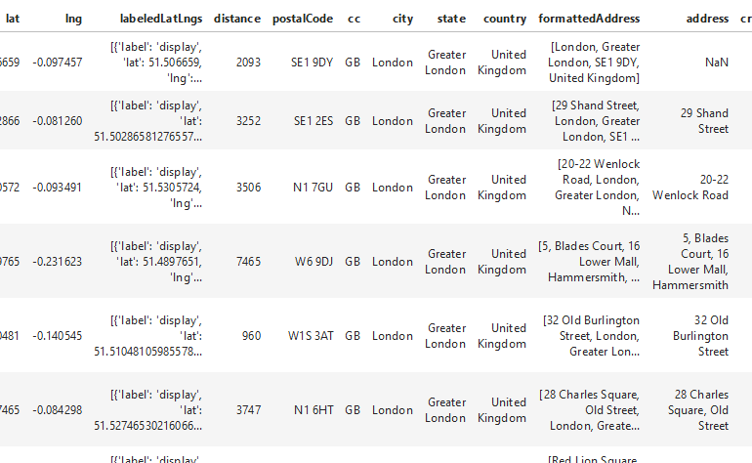
The Data
The data being used comes from the Foursquare API, which has one of the largest geolocation databases. The quality of the data is also higher due the fact I am focusing on a major global city.
The data underwent relevant cleaning and filtering methods to ensure the most efficient analysis

Slide 5
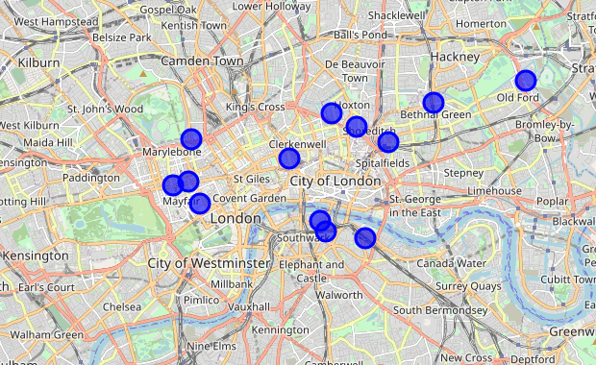
Results
There were 3 distinct areas where clusters existed:
Mayfair
Shoreditch
Southwark

Slide 6
Recommendations
Tourists – The most appropriate area to focus their shopping is Mayfair, however they should consider venturing into the other 2 areas also
Residents – They should focus house search efforts in Shoreditch and Southwark, due the high density of populations in these areas as well as access to sustainable venues
Local Authorities – They should focus any initiatives to grow sustainable and ethical business in all 3 of the core areas identified

Slide 7
Summary
This study identified three core areas for sustainable and ethical businesses in Central London
There are opportunities for tourists, residents and local authorities to grow their awareness of where the “green” businesses are in areas that are of interest to them
Future considerations for this study should involve further datasets that identify key data such as neighbourhood data (ie, density, cost, etc) and most popular tourist sites and their proximity to ethical businesses

